Slide 1
Capstone
battle of the neighbourhood

Slide 2
Introduction
client wants to invest a short-term rental apartment in Chicago.
do some research on the data of Chicago to help him make a decision of location of apartment.
The purpose of the project is to solve the problem:" the locations in Chicago can be potential choices to invest his rental apartment.

Slide 3
Background of Chicago
the most populous city in Illinois and the third most populous city in the US
Locates on the shores of Lake Michigan.
one of the important centers of economy, education as well as culture.
nearly sixty million visitors come to this city every year

Slide 4
Background of Chicago (Cont.)
international airport ranks top six busiest airport
lots of unique landmarks including its museums, buildings designed by famous architectures as well as some world wide famous universities
a major world financial center.
third largest labor pool in the US.

Slide 5
rental investment
Large amount of the population and good economy
marketing factors such as competition or the demand nearby
economic factors and the preference of the customers
7 million properties have been listed as short term rental properties
2 million people stay in short term properties every night
choose the properties that can make them feel like a “home away from home.”
whether the property is close to urban centers or top hot venues
the privacy of the property;
the safety of the environment.

Slide 6
Data Description
The FourSquare:
the data from foursqaure about the Venues in Chicago the people would like to visit. The popular places provide good source of customers.
The Chicago Police Department:
Crime data from the Chicago Police Department

Slide 7
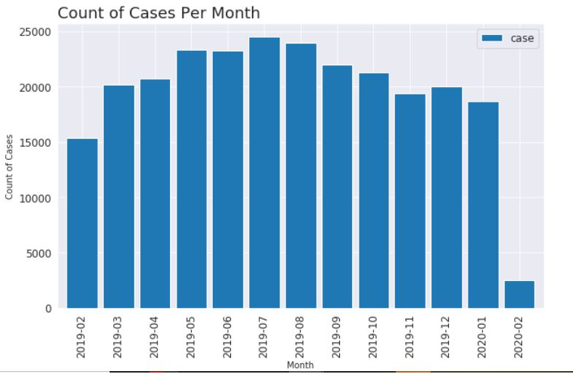
Methodology and Results

Slide 8
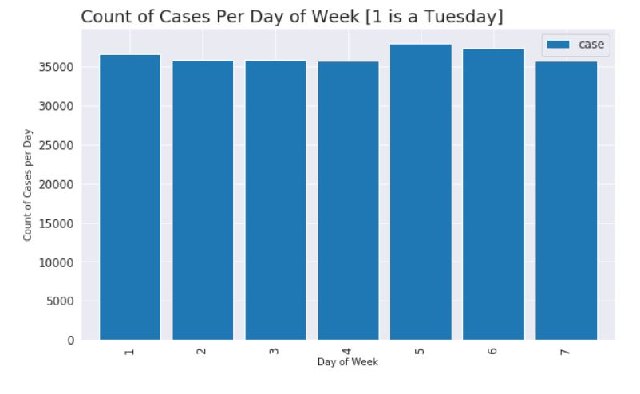
Methodology and Results

Slide 9
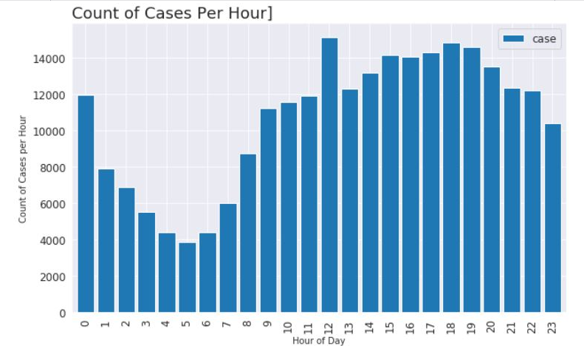
Methodology and Results

Slide 10
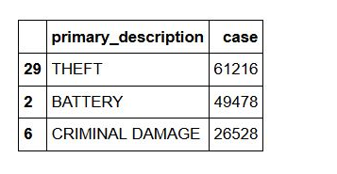
Methodology and Results

Slide 11
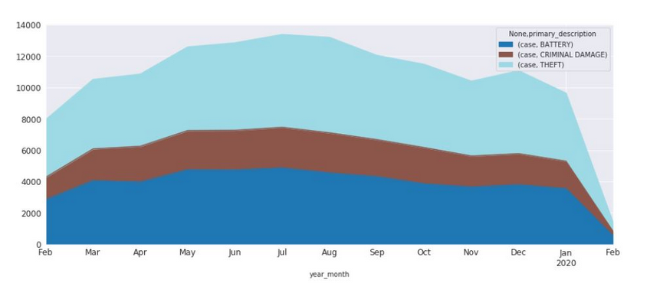
Methodology and Results

Slide 12
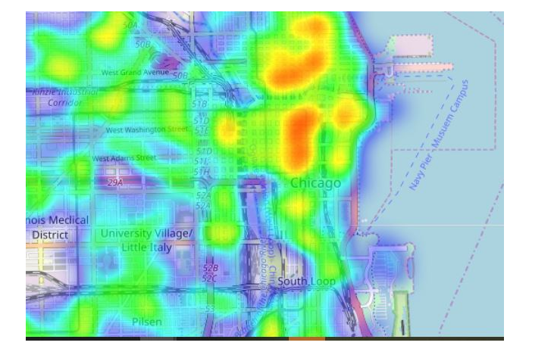
Methodology and Results

Slide 13
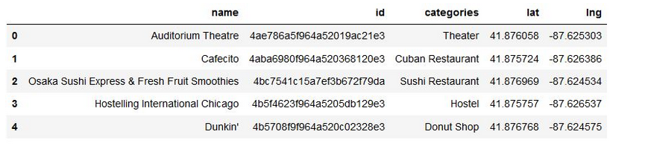
Methodology and Results

Slide 14
Discussion and Conclusion
The above provides the information about the general possible choices for the location the client can consider to invest. However, for short - term rental investments, it is also important to consider investment budget, the potential investment return, and the price of the houses, etc.

